Slide 1
3PUB
Notes:
AMANDA

Slide 2







@agomm
@tommcluskey
@digitalbindery
#3pub
Notes:
AMANDA

Slide 3
A basic introduction to epub and what’s new in 3.0
Review of tools and files we’ll be using
Dissection of an epub 2.0 file
Conversion of epub 2.0 to epub 3.0 (3pub to its friends)
  Overall structural changes
  New semantic information
  HTML5
  Media overlays
  Text-to-speech tools
  <switch> and backwards compatibility
  Canonical Fragment Identifiers
  Scripting
  CSS changes
Questions and (hopefully) answers!
Notes:
TOM
So, in the course of this workshop, we’re going to take an epub 2.0 file and turn it into an epub 3.0 (3pub) file.
Before we get into the nuts and bolts of how we do that, we’re going to go over the tools that we use and (briefly) how to set them up. We’ll also take a look at some of the other content that we’ve got that we’d like to include in the new file.
We’ll gloss over the epub 2.0 file that we’ve got, just to make sure that everyone is one the same page and understands the basics of how epub 2.0 works. If you have questions about 2.0 and how to generate epubs in general, we can give some quick pointers during this talk, and we’re happy to go into more depth afterwards.
After making sure we’re all on the same page with epub 2, we’ll head for 3pub. The first thing we’ll be looking at here are the overall structural changes to the format. These are changes that don’t add to the content—they just make the file a valid 3pub document. After that, we get into the new stuff that we can add in. The first content change we’ll be looking at is the new level of semantic information that 3pub introduces. This kind of information is great for enabling future re-use of your content; basically, it lets your device know more about the content it’s presenting.
HTML5 is next. It’s a really big subject, and there’s a full workhops about it right here after lunch, so while we’ll definitely get into some of the new features, we’ll be glossing over a lot. Mostly we’ll be looking at MathML, audio and video, triggers, and scripting. Following that, it’s Media Overlays, which are a method of integrating textual and audio content. Then we’ll look at backwards compatibility and ways that we can ensure that older reading systems don’t get left behind. We’ll finish up the presentation portion with a look at the CSS changes from epub 2.0.
We’ll finish up with a question and answer session. Since this is a big subject and a lot of these things build on each other, we’ll also be taking questions after each section. Feel free to ask away; this is a pretty technical subject, and odds are good that if you’re wondering it, ten or twelve other people are too.
We’ve also got a half-hour break scheduled in the middle there somewhere; we’ll take that as it comes

Slide 4
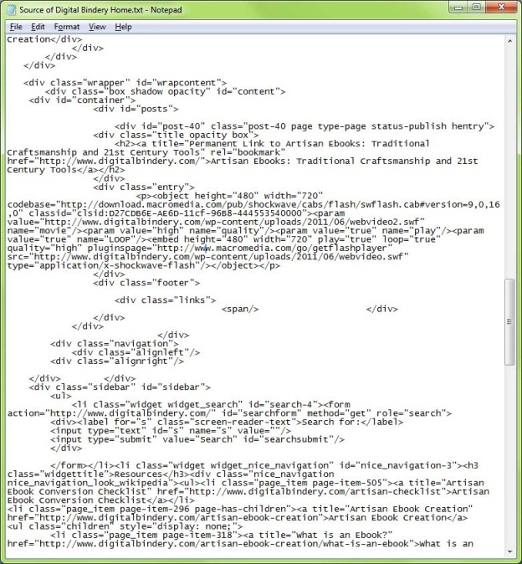
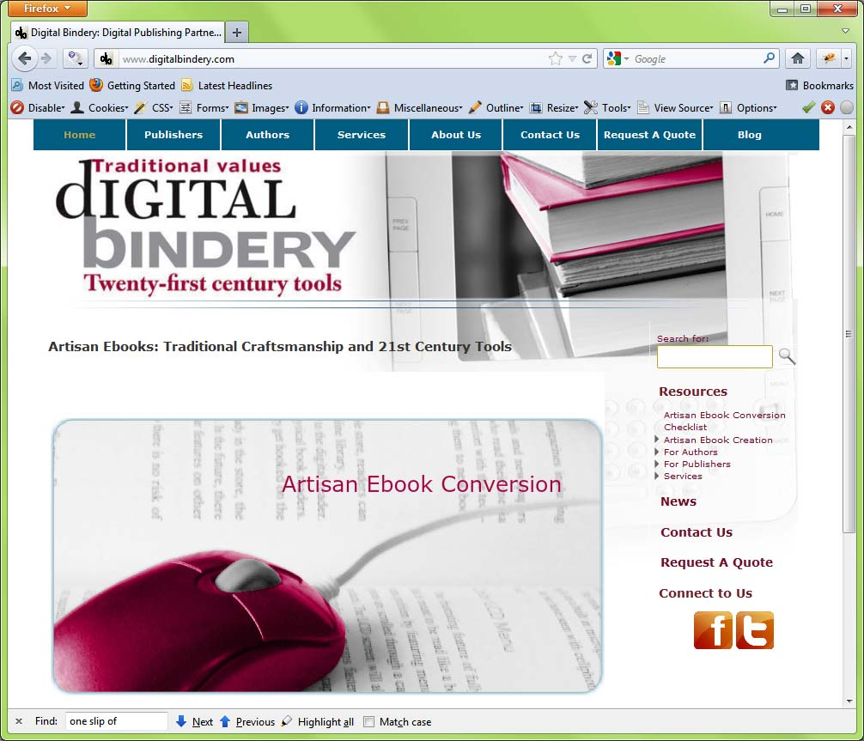
What’s an epub?
Notes:
AMANDA
EPUBs work a lot like web pages work. Web pages are just a bunch of text with special instructions on how to display the content and where to place images and other elements. A web page isn’t a program. It’s a bunch of data that a program like Internet Explorer or Firefox, or Chrome can display.

Slide 5
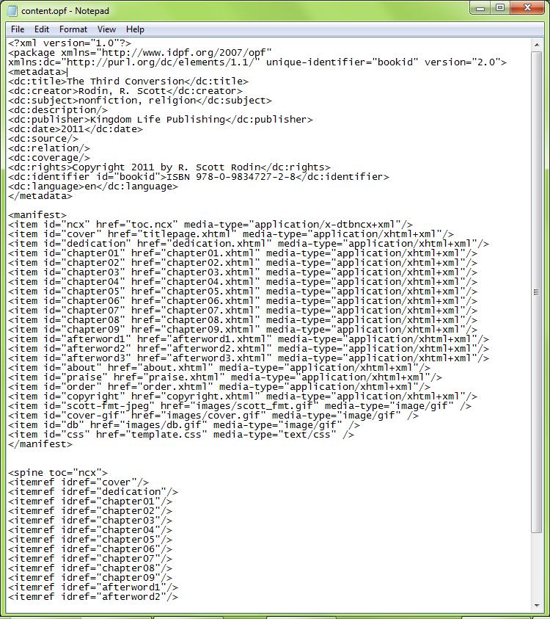
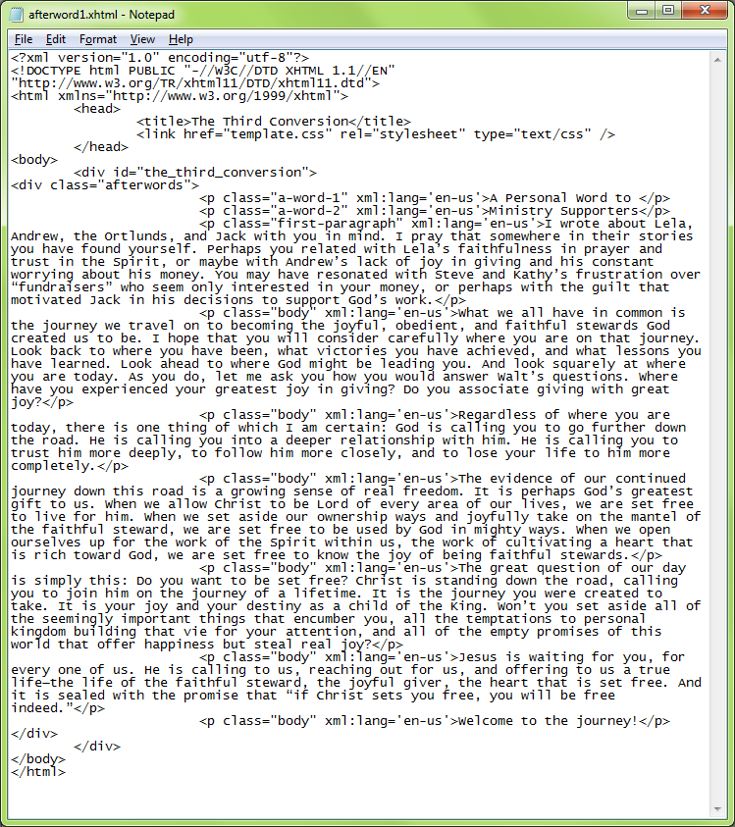




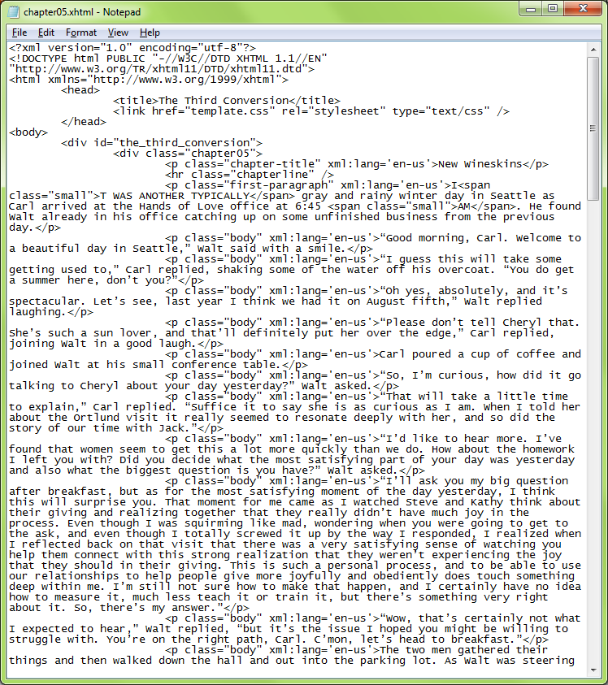

What’s an epub?
Notes:
AMANDA
We start with a bunch of text files. We put them into specific folders in the right order or sometimes just leave them alone, cram everything into a zip file, then just rename the zip file to .epub. No special programs are required and it’s not a program in itself. It’s just a bunch of data that the ereader like the iPad or the Kobo reader or the nook can display.

Slide 6
What’s an epub?
Ebook format developed by the IDPF
Very widely used
Non-proprietary, open format
Notes:
TOM

Slide 7
What’s epub 3.0?
The latest and greatest version of the epub format
Approved in October 2011
Lots of shiny new toys like multimedia capability, scripting support, and media overlays
Notes:
TOM
Not technical here: epub is an ebook format developed by the fine folks at the International Digital Publishing Foundation (IDPF). It’s probably the mostly widely-used format out there, and is available on a huge number of devices. It’s an open, non-proprietary format, which means that it’s not locked to one particular device or manufacturer.
Epub 3.0 is the newest version of the format. It was approved in October, and is so new that there are very few reading systems out that support is, and none that we’re aware of that support all the possible bells and whistles.

Slide 8
Tools we will use
A basic introduction to epub and what’s new in 3.0
Review of tools and files we’ll be using
Dissection of an epub 2.0 file
Conversion of epub 2.0 to epub 3.0 (3pub to its friends)
  Overall structural changes
  New semantic information
  HTML5
  Media overlays
  Text-to-speech tools
  <switch> and backwards compatibility
  CSS changes
Questions and (hopefully) answers!
Notes:
AMANDA

Slide 9
Tools we will be using:
A Text Editor
  Notepad++ (PC only)
  Macpad++, Kod?
Epubcheck
  epubcheck
  JDK 1.5+
  Apache Ant 1.6+
A Good Zipper-Upper
  Winrar
  Infozip
Browser(s) that support
  HTML5
  CSS3
  MathML (plugins/native)
  Javascript
Reference Materials
  EPUB 3.0 Specifications
  W3C specifications
www.digitalbindery.com
Notes:
AMANDA

Slide 10

XHTML, WTF? or
Amanda teaches XHTML in 5 minutes or less
eXtensible HyperText Markup Language
Make the text inside of these tags do what I say
<bold>text</bold>
text
Notes:
AMANDA
XHTML stands for  Extensible Hypertext Markup Language. XHTML is just a stricter form of HTML.
Any markup language is simply a way to annotate text so a computer knows what to do with it.
 The term markup originates with editorial markups on print manuscripts
Instead of looking like this  they now look like this
They still communicate the same sorts of things. Instead of a squiggly underline, or double stroked backwards P thing, we use small snippets of code to say:
 Make the  text inside of these  tags do what I say.
The reading device, or webpage will interpret these tags to produce text  like this

Slide 11
Important computery gobbledy gook
<?xml version="1.0" encoding="UTF-8"?>
<html xmlns="http://www.w3.org/1999/xhtml"
xmlns:epub="http://www.idpf.org/2007/ops">
<html>
  <head>
  </head>
  <body>
  </body>
</html>
Meta information
<title>Title</title>
<link>Links to important stuff like stylesheets or javascript</link>
Content/Visible stuff
<div>
  Biggest container of junk—like sections within a chapter.
    <p>
    Paragraphs that contain sentences. And smaller spans that could hold things like <span>bold words </span> or <span>italic words </span>.
    </p>
</div>
Notes:
AMANDA
Since XHTML is just a strict version of HTML, we still use the HTML tag here instead of an XHTML tag.
The two important differences when moving from HTML to XHTML are
every time you ‘open’ a tag, you must close it and
things must nest properly.
Think of Russian Nesting Dolls. If you try to put your nesting dolls together without closing the smallest dolls first, you end up with extra pieces and an malformed doll. It’s the same with XHTML.
We’ve got the HTML element opening first and closing last.
Within the HTML element we have the head and body section, both closing properly.
They are not nested, they are in sequence.
If the HTML tag had closed before the body tag, the body tag would be stuck half in and half out of the HTML tags. The document would break.
This is the basic XHTML document structure. There are different spots that require specific types of information.
 First you have important information required for the software. This comes first, before anything else.
 Second you’ve got Meta information that goes in the ‘head’ of the document.
 Finally, you’ve got the content within the body tag. Smaller containers fit inside of this section.
The div is the container that can hold the most within the body section. It can hold the entire chapter if you want. It is intended to DIVide large blocks of content.
Within the divs are paragraph tags which hold—paragraphs. Without any styling, the p tag has default margins that produce space between paragraphs.
Within sentences—the smallest of the containers are spans.
The same nesting rules apply to spans, ps and divs.

Slide 12
Common XHTML tags as seen in EPUBs
Containers
  <div></div>
  <p></p>
  <span></span>
Headers
  <h1></h1>
  <h2></h2>
Links
  <a></a>
Images
  <img />
Lists
  <ol>
    <li>First List Item</li>
    <li>Second List Item</li>
  </ol>
  <ul>
    <li>Bulleted item</li>
    <li>Bulleted item</li>
  </ul>
Spoilers!
  <video></video>
  <audio></audio>
Horizontal Rules
  <hr /> (shortcut for <hr></hr>)
Captions
  <caption></caption>
Blockquotes
  <blockquote></blockquote>
Resource
  www.w3schools.com
Notes:
AMANDA
Here are some of the most common XHTML tags you’ll see in EPUBs.
Containers, Headers, Lists, Video, Audio, Horizontal Rules, Blockquotes, Links, Images, and Captions.
There are a lot more, and you don’t need to worry about memorizing all of these. You’ll gradually memorize the ones you use the most often, but there are great resources available for looking up HTML tags  w3schools.com is one of the best. This is just meant to give you a very cursory idea of what’s possible and help you get the gist for how things are named. Usually the tags make some kind of sense once you know what they are intended to do.

Slide 13
tag
attributes
<p class="body" id="harker1" style="color:red">
CSS
CSS & Interactive Elements
Ew. Yuck.
Notes:
AMANDA
Other things can go inside of tags. These are called attributes. They can be things like
class assignments—which is one way that we assign CSS styles
id reference names, which we can also use to assign styles in CSS, but is very important for identifying objects for interactive elements like JavaScript
inline style tags which is an inelegant and kinda gross way to do what you should be doing with the style sheet

Slide 14
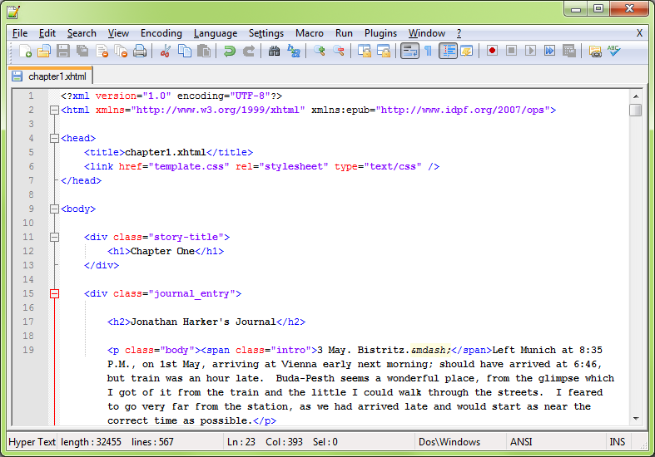
Notes:
AMANDA

Slide 15
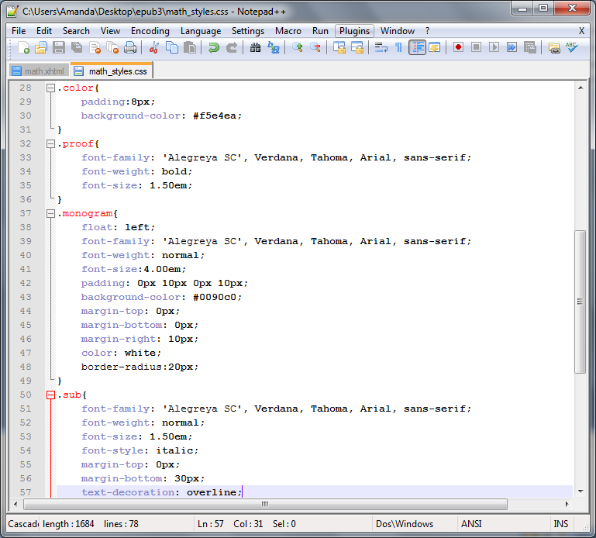
Cascading Style Sheets (CSS)
Text file that defines styles
Referenced in the <head> of the XHTML file
Central location to affect the all referring documents
Cascading ≈ Overriding
Notes:
AMANDA

Slide 16
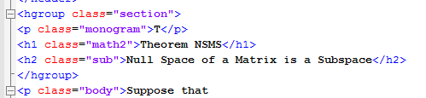
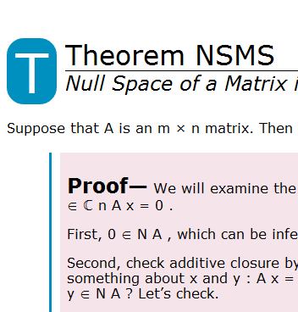
Cascading Style Sheets (CSS)

Slide 17
Epub 2.0.1 Dissection
A basic introduction to epub and what’s new in 3.0
Review of tools and files we’ll be using
Dissection of an epub 2.0 file
Conversion of epub 2.0 to epub 3.0 (3pub to its friends)
  Overall structural changes
  New semantic information
  HTML5
  Media overlays
  Text-to-speech tools
  <switch> and backwards compatibility
  CSS changes
Questions and (hopefully) answers!
Notes:
TOM
Right, so now that we know what files we’re dealing with and the tools that we have to deal with them, we’re moving along to how the old epub 2.0 works, so that we can take it apart and make a shiny new 3pub out of it.

Slide 18
Opening up the epub file
An epub file is really just a .zip file with a specialized structure
And it’s just as easy to take it apart as to put it together
Notes:
TOM

Slide 19
Inside the epub
There are three main parts inside the .zip file
mimetype
OEBPS folder
META-INF folder
epub
mimetype
OEBPS
META-INF
Notes:
TOM
The mimetype is the file that tells the reading system "hey, this is an epub." It’s unchanged from version 2.0.1. The most important this to note about it is that it has to be the first file in the compressed archive (the zip file) and it can’t be compressed itself. WinRAR does both of these things admirably.
The META-INF contains meta-information about the title. There can be all sorts of information in here, about DRM and encryption and rights and stuff. At its most basic, it’s just a roadmap pointing to the content of the book; the reading system comes here first, and the contents of the META-INF folder say "oh, the stuff you want is over there." There are no changes here either; this can stay the same as in epub 2.0.1

Slide 20
The OEBPS file
OEBPS
XHTML
template.css
content.opf
toc.ncx
folders for other content
Content of the book
Layout of the book
Built-in table of contents
Navigation and list of all the pieces
Everything else
Notes:
TOM
Stands for Open E-Book Publication Structure. This is where things get meaty; all the good stuff is in the OEBPS file. There are four main types of item in here: the XHTML file (or more likely files) that make up the ebook; the CSS files that define how the ebook should look; the built-in table of contents; and a navigational document that, among other things, lists every file used by the ebook. There are also more folders in here where things like images and fonts can go.

Slide 21
XHTML files
All the textual content of the book
Usually one file per chapter
Generally no layout, just classifications of types of content (this is a header, and that is body text)
Notes:
TOM
The XHTML files hold most of the content of the ebook; all of the text is in these files. The content is generally broken into one chapter per file—basically, if you want it to be a distinct TOC entry, it should be its own file.

Slide 22
CSS files
Define how the classifications in the XHTML files look (headers are all bold, centered, 16 point Garamond)
Multiple CSS files are supported
Notes:
TOM

Slide 23
toc.ncx: The Table of Contents
Does what you’d think: lists the documents that you want people to have ready access to.
Controls what shows up in the built-in TOC
Not all items need to be listed
Two properties for each TOC item: nav id and playorder
Nested TOC entries work on most reading systems
Notes:
TOM

Slide 24
Navigating content.opf
<metadata> holds information about the book, like author, publisher, and rights.
<manifest> is a complete list of all the files that make up the ebook.
<spine> declares the order that the reading system navigates the ebook in.
<guide> gives more semantic information about the parts of the ebook.
Notes:
TOM
content.opf does a lot. First, it lists metadata about the book, including stuff like the author, the publisher, a unique identifier (usually the ISBN), and rights information.
It’s also a navigation document that lists every file that makes up the ebook: all the xhtml files, the css, any illustrations or fonts you might use, the toc.ncx—everything.
In addition to listing the items, it declares what kind of items those are: whether a given file is an image, a font, xhtml, or simple text. All of that information goes in the manifest.
Then there’s the spine, which tells the reading system the order of the sections of your ebook. This is distinct from the NCX file, which basically lets you jump around. The spine is all about forward-and-back navigation.
The last part of the OPF file is the guide, which gives semantic information about the parts of the book—it tells you which file is an epilogue and which is an index. This is optional, and doesn’t get used as often as it should.

Slide 25
Conversion to 3pub
A basic introduction to epub and what’s new in 3.0
Review of tools and files we’ll be using
Dissection of an epub 2.0 file
Conversion of epub 2.0 to epub 3.0 (3pub to its friends)
  Overall structural changes
  New semantic information
  HTML5
  Media overlays
  Text-to-speech tools
  <switch> and backwards compatibility
  CSS changes
Questions and (hopefully) answers!
Notes:
TOM

Slide 26
Structural Changes
toc.ncx has been replaced by toc.xhtml (the Epub Navigation Document)
The <guide> has been replaced by the nav landmark
nav page-list replaces <pageList>
dcterms:modified is a new requirement
No more DTBook support.
Additions
<link> allows you to reference external metadata records, like ONIX records
properties can be used to declare metadata about certain parts of the document. Many are situationally required.
Notes:
TOM
The toc.ncx is not used in epub3; it has been replaced by the epub navigational document, or END. The END is much more human-readable, which makes it also more human-writable—you don’t have to worry nearly as much about forgetting to update a page id number. The new TOC can also be included in the spine of the document, which means that the same document that generates the built-in TOC in the reading system can also be displayed directly to the user, completely styled.
The guide element in the old toc.ncx has been replaced by nav landmarks, which do basically the same thing: they provide information to the Reading System about the purpose of various parts of the manuscript. We’ll get more into these types of semantics soon; for now, just know that the <guide> is different and will have to be changed if you have one.
Similarly, if your epub 2.0 has a <pageList>, you’ll need to replace it with a nav page-list. This is just what you’d expect: a list of all the page breaks in the manuscript. This basically tells the Reading System where all the page breaks in the print version are, which some Reading Systems can present to users.
dcterms:modified is a new metadata requirement. This basically acts in concert with the ISBN (or whatever unique id you use) to ensure that the proper version is being referred to. As we’ll see shortly, this is a timestamp that specifies that not only is this ISBN x, but it was last modified on February 14th at 10:45 GMT.
<link> is a new child element for <metadata>; it’s basically a way of associating external metadata, like your ONIX record, with the file.
properties are how you tell the Reading System that one chapter has a media overlay associated with it, or that another has SVG content. It’s required in a lot of situations, mostly for when you’re adding in Bells and Whistles.

Slide 27
Structural changes: How To
Open up the OPF file and change version="2.0" to version="3.0"
Notes:
TOM
This is the first and most basic change to make. This basically lets Reading Systems know which version of the epub format they’re looking at—what dialect they’re speaking, basically. At this point, what had been a perfectly valid epub 2.0.1 document will return a huge string of errors on epubchceck, since epubcheck will think it’s looking at an epub 3.0 document.

Slide 28
Version tracking
Notes:
TOM
The highlighted line at the bottom of the image is a new requirement. This, combined with the ISBN that’s listed at the cd:identifier two lines above, is what ensures that you know exactly what version of the manuscript you’re looking at. The format is quite straightforward, in year-month-date, followed by a T, followed by the time in GMT. This is easy to forget to put in; when I first made a 3pub file, I got the message that dcterms:modified had to occur exactly once, so I spent ages trying to figure out where it was declared twice. The problem, of course, was that it wasn’t declared at all.

Slide 29
Introducing xmlns:epub
Notes:
TOM
This is a change to the XML namespace. The Doctype declaration can go away first; it’s not needed anymore because HTML5 is not SGML based. After that, you add the epub prefix. This basically adds some elements to the default XHTML that are designed specifically for epub. These are the elements that will provide us with a lot of the semantic information that we’ll be covering shortly. This is a change that has to be made in every xhtml file that makes up the epub. Notepad++’s global find and replace comes in really handy here.

Slide 30
The Epub Navigational Document
Notes:
TOM
This is the bare-bones basics of what you need in an epub 3.0 END. If you’re familiar with HTML, you’ll be able to see that the document on the right, which is the TOC.XHTML, is just a straightforward ordered list; it’s quite easy to parse. The document on the left is the old TOC.NCX. It’s full of navPoints and playOrders and all sorts of stuff. What’s really great about the TOC.XHTML, though, is that if you include it in the <spine>, it’s viewable to users. The only way you could do that in epub 2.0 was by having two different documents, one for the Reading System and one for the user. Epub3 combines those.
Important points to note here are the <nav> element, which must get epub:type="toc". While you don’t need the id="toc" attribute, it’s not a bad idea. Note that the header of the list is an <h1>; this is required—you can’t just use a <p>

Slide 31
Finished!
Notes:
TOM
At this point, barring any typos you just need to package the files back up, rename the ZIP file .epub, and you should have a valid epub 3.0 document. This is epub 3.0 at its most basic; we haven’t even begun to look at its new semantic possibilities, let alone the multimedia bells and whistles, scripting, and HTML5. We’ll start on that stuff soon, but first—does anyone have any questions about anything that we’ve covered so far?

Slide 32
A basic introduction to epub and what’s new in 3.0
Review of tools and files we’ll be using
Dissection of an epub 2.0 file
Conversion of epub 2.0 to epub 3.0 (3pub to its friends)
  Overall structural changes
  New semantic information
  HTML5
  Media overlays
  Text-to-speech tools
  <switch> and backwards compatibility
  CSS changes
Questions and (hopefully) answers!
Notes:
TOM

Slide 33
epub:type and semantic inflection
Attaches meaning to pieces of the document to describe purpose or function
Not intended for human consumption
Refine, not redefine
The parent element trumps epub:type
Can apply multiple types to one element
Notes:
TOM

Slide 34
epub:type terms
Lots of different terms available; check http://idpf.org/epub/vocab/structure/# for a full list
Types can be broad or narrow
Types apply to only certain elements
Some types are restricted further
Reading Systems can do with epub:type as they will
Notes:
TOM
There are about 70 different epub:type terms; it’s a good idea to browse the list on the IDPF site before getting started assigning epub:type to your manuscript so that you know what the options are. In general, the odds are good that if a piece of text has a specialized function, it’s in there. Types can be broad, like volume or chapter, or they can be much more specific, like topic-sentence or keyword. Which types you use is up to you; some types might not be useful for all publications. Declaring every topic sentence in a novel might not be very important, but it could be much more useful in a textbook.
Most of the types will only apply to certain elements: the types that describe titles and subtitles all have to apply to header elements, for example, and the ones that describe references have to be on hyperlinks. A few of the types are limited further, specifically the types that define tables and lists. These shouldn’t be used in the regular content of the document, as they don’t add anything to the information that the XHTML already provides. Instead, they’re used in media overlays (which we’ll get into later) to define which parts of a text being read are lists or tables.
Reading Systems don’t have to use the information included in epub:type in any particular way. They can also have System-specific terms that they use. While it’s conceivable that this could lead to, for example, Apple and nook having two different types that do the same thing on each of their devices, that’s likely to only be an inconvenience rather than a problem, because you can assign multiple types to any element.

Slide 35
Notes:
TOM
Here’s an example of one of the neat things you can do with epub:type. What we’re doing here is providing the Reading System with a list of where all the page breaks in a particular print edition are. This could help with page references in books, such as those in an index.
What you see here are three snippets of code from various files inside the epub. The top one is from one of the text documents; you can see on the tab that this is chapter2.xhtml. The first two lines there are regular body text—we’ll get into why the sentences all have numbered IDs in a bit; you can ignore that for now. The third line is the important one for us. What we’ve got here is a <div> that has been declared to be a page break with epub:type. It’s also been assigned both a title and an id. The id allows the Reading System to find this place later, and the title is something that a Reading System could choose to display.
The next snippet of code is from the toc.xhtml—our Navigational Document. This comes after the toc nav element; you can see on the margin there that we’re starting on line 37. So we’ve got a <nav> element, and it’s been assigned the type page-list, so the Reading System knows this is a list of all the pages in the book. It’s also got the HTML attribute "hidden", which means that it won’t be displayed to the user when the user is looking at the Table of Contents. Then there’s an ordered list, just like in the Table of Contents, with hyperlinks referring to chapter2.xhtml, and more particularly to the ids that we assigned each page break.
You can assign "hidden" attribute to elements in <nav> lists to keep them from showing up when users view the toc.xhtml. Handy for making things more readable, and particularly for stuff like page break lists. You can use CSS to hide stuff too, but not all Reading Systems use CSS. You can also hide just parts of lists, so that if you have a manuscript with volumes and chapters and sections and subsections, you can hide some of the extreme granularity, making the list more human-readable, but still have all that information available for the Reading System.
The final snippet of code is from the <metadata> section of content.opf. We’re looking at the highlighted bit that starts "dc:source". This metadata tells us which print version of the book we’re basing the ebook on, which is of course important when we’re looking at page numbering. Understandably, you can only list one source document.
<span epub:type="pagebreak" title="234" />
Use <dc:source id="src-id">urn:isbn:978037470424</dc:source> in the OPF metadata to declare what version of the book the page numbers are from
Only one source element is allowed

Slide 36
Metadata
Notes:
TOM
Required: title, identifier, language. Also the "modified" property. The DC in all of these stands for Dublin Core, which is the metadata standard being used.
You can have multiple identifiers, but one of them must be the unique id, and it must be declared in the <package> element (referred to by id). Typos and minor markup problems can be fixed without changing the unique id—though you’ll have to update the dcterms"modified, of course. Any major changes require a new unique id, just as they would require a new ISBN. The unique id can be anything that you want, but it is "strongly recommended" that you use a Uniform Resource Identifier, or URI. The easiest way to do this is to use the isbn, as shown here.
Language is pretty straightforward; you can specify multiple languages, if that’s appropriate.
Titles get more complex, and will be dealt with on the next slide.

Slide 37
Options for <dc:title>
Multiple titles possible
  Main title
  Subtitle
  Collection name
  Edition
Falls back to main title
  If not defined, the first title listed is used
Notes:
<metadata xmlns:dc="http://purl.org/dc/elements/1.1/">
<dc:title id="t1">The Fellowship of the Ring</dc:title>
<meta refines="#t1" property="title-type">main</meta>
<dc:title id="t2">The Lord of the Rings</dc:title>
<meta refines="#t2" property="title-type">collection</meta>
<meta refines="#t2" property="group-position">1</meta>
<dc:title id="t3">THE LORD OF THE RINGS, Part One: The Fellowship of the Ring</dc:title>
<meta refines="#t3" property="title-type">extended</meta>
…
</metadata>

Slide 38
Other dc:terms
contributor
coverage
creator
date
description
format
publisher
relation
rights
source
subject
type
Notes:
Contributor: straightforward.
Coverage: useful for technical stuff, law books, history books, etc. Lists the topic, space, and/or time being covered.
Creator: Likewise. You can have multiple creators listed. If you don’t declare which one gets shown, the RS will pick the first listed. You can also specify (with property: file-as) normalized forms of named (like last, first), and property: alternate-script for other scripts.
Date: publication date, which is different than the last-modified date. Only one allowed.
Description, format, publisher: straightforward
Relation: a related resource
Rights: straightforward
Source: already covered
Subject: straightforward
Type: "the nature or genre of the resource"—indicates the publication is of a specialized type. IDPF hasn’t defined values, and has left those to occur independently.

Slide 39
Landmarks
Similar to Table of Contents
Lists types of content by epub:type
Shows up in toc.xhtml
<nav epub:type="landmarks">
<h1>Guide</h1>
<ol><li><a epub:type="toc" href="#toc">Table of Contents</a></li>
…
</ol>
</nav>
Notes:
Distinct from TOC in that it provides a list of the types of content; the TOC, LOT, Frontmatter, Backmatter, etc would get listed, and the Content would get listed once. This would be a much shorter list than the TOC.
The format should be quite familiar; this is virtually identical to the Table of Contents layout. Note that when you give the link for the TOC, you don’t even need to specify the file name, as the thing being referenced is in the same file this is. For other items, of course, you do.

Slide 40
3pub adds semantics through:
epub:type
dc:terms in the metadata
Specialized navigation lists

Slide 41
A basic introduction to epub and what’s new in 3.0
Review of tools and files we’ll be using
Dissection of an epub 2.0 file
Conversion of epub 2.0 to epub 3.0 (3pub to its friends)
  Overall structural changes
  New semantic information
  HTML5
  Media overlays
  Text-to-speech tools
  <switch> and backwards compatibility
  Canonical Fragment Identifiers
  Scripting
  CSS changes
Questions and (hopefully) answers!
Notes:
So, in the course of this workshop, we’re going to take an epub 2.0 file and turn it into an epub 3.0 (3pub) file.
Before we get into the nuts and bolts of how we do that, we’re going to go over the tools that we use and (briefly) how to set them up. We’ll also take a look at some of the other content that we’ve got that we’d like to include in the new file.
We’ll gloss over the epub 2.0 file that we’ve got, just to make sure that everyone is one the same page and understands the basics of how epub 2.0 works. If you have questions about 2.0 and how to generate epubs in general, we can give some quick pointers during this talk, and we’re happy to go into more depth afterwards.
After making sure we’re all on the same page with epub 2, we’ll head for 3pub. The first thing we’ll be looking at here are the overall structural changes to the format. These are changes that don’t add to the content—they just make the file a valid 3pub document. After that, we get into the new stuff that we can add in. The first content change we’ll be looking at is the new level of semantic information that 3pub introduces. This kind of information is great for enabling future re-use of your content; basically, it lets your device know more about the content it’s presenting.
HTML5 is next. It’s a really big subject, and there’s a full workhops about it right here after lunch, so while we’ll definitely get into some of the new features, we’ll be glossing over a lot. Mostly we’ll be looking at MathML, audio and video, triggers, and scripting. Following that, it’s Media Overlays, which are a method of integrating textual and audio content. Then we’ll look at backwards compatibility and ways that we can ensure that older reading systems don’t get left behind. We’ll finish up the presentation portion with a look at the CSS changes from epub 2.0.
We’ll finish up with a question and answer session. Since this is a big subject and a lot of these things build on each other, we’ll also be taking questions after each section. Feel free to ask away; this is a pretty technical subject, and odds are good that if you’re wondering it, ten or twelve other people are too.
We’ve also got a half-hour break scheduled in the middle there somewhere; we’ll take that as it comes

Slide 42
HTML5 Support
HTML 5 Specified
EPUB3 Enhancements
EPUB3 Deviations

Slide 43
HTML5 Support
HTML5 is not a fixed standard
Notes:
//add table of supported features with reference/resource. Wikipedia is pretty good.

Slide 44
HTML5 Support
What might be gone:
Deprecated Elements
frame
frameset
noframes
basefont
big
center
font
s
strike
tt
u
acronym
applet
isindex
dir
Deprecated Attributes
All Block Level Elements
  align
body
  background
a/link
  rev
  charset
img
  longdesc
  name
  hspace
  vspace
html
  version
table, tr, th, td
  bgcolor
table
  border
  cell padding
  cell spacing
  valign
td, th
  height
  width
th
  abbr
td
  scope

Slide 45
HTML5 Support
What might be new:
Content Tags
video
audio
embed
canvas
Structural Tags
article
aside
figure
header
hgroup
footer
nav
Section
Figcaption
Others
meter
progress
time
details
command
menu
datalist
mark
output
rp
ruby
source
summary
Keygen
Integrated APIs
Audio/Video
Offline Application
Inline Editing
Drag & Drop
History
Protocols
www.w3.org

Slide 46
HTML5 Support
3PUB Enhancements
Prefix
epub:type
epub:switch
  epub:case
  epub:default
epub:trigger
Alternate Style tags
SSML

Slide 47
HTML5 Support: Prefix
<html xmnls:epub="http://www.ipdf.org/ops"
xmnls:m="http://www.w3.org/1998/Math/MathML">
<m:math>
<epub:type>

Slide 48
HTML5 Support: epub:trigger
Definition:
  When the reader does something, something else happens.
Uses:
  Multimedia playback control without scripting

Slide 49
HTML5 Support: epub:triggers
Structure:
  <head>
    <epub:trigger
      id="optional"
      ev:observer="source of the trigger"
      ev:event="reader instigated event"
      action="what device will perform"
      ref="IDREF of object of the action" />
  </head>
  <body>
    <video id="movie1" src="movie.mp4" width="320" height="240" />
    <span class="button" id="pause-button">Pause</span>
  </body>

Slide 50
HTML5 Support: epub:triggers
ev:observer
  The id of the element that is listening for the event
Example:
  When the ev:event happens to ev:observer (when the pause-button is clicked) the action happens to ref (the video named movie1 is paused).
  <epub:trigger ev:observer="pause-button" ev:event="click" action="pause" ref="movie1"/>
  <video id="movie1" src="movie.mp4" width="320" height="240"/>
  <span class="button" id="pause-button">Pause</span>

Slide 51
HTML5 Support: epub:triggers
ev:event
Sets what event will instigate the action
Mouse Events
  click
  mousedown
  mouseup
  mouseover
  mousemove
  mouseout
HTML events
  load
  unload
  abort
  error
  select
  change
  submit
  reset
  focus
  blur
  resize
  scroll

Slide 52
HTML5 Support: epub:triggers
ev:event
Example:
  When the ev:event happens to ev:observer (when the pause-button is clicked) the action happens to ref (the video named movie1 is paused).
  <epub:trigger ev:observer="pause-button" ev:event="click" action="pause" ref="movie1"/>
  <video id="movie1" src="movie.mp4" width="320" height="240"/>
  <span class="button" id="pause-button">Pause</span>

Slide 53
HTML5 Support: epub:triggers
action
Defines what the device will perform
action="show" - sets visibility to visible
      hide" - sets visibility to hidden
      play" - plays the video or audio
      pause" - pauses playing
      resume" - resumes playing
      mute" - mutes the sound
      unmute" - unmutes the sound

Slide 54
HTML5 Support: epub:triggers
action
Example:
  When the ev:event happens to ev:observer (when the pause-button is clicked) the action happens to ref (the video named movie1 is paused).
  <epub:trigger ev:observer="pause-button" ev:event="click" action="pause" ref="movie1"/>
  <video id="movie1" src="movie.mp4" width="320" height="240"/>
  <span class="button" id="pause-button">Pause</span>

Slide 55
HTML5 Support: epub:triggers
ref
Identifies the item that will receive the action.
Example:
  When the ev:event happens to ev:observer (when the pause-button is clicked) the action happens to ref (the video named movie1 is paused).
  <epub:trigger ev:observer="pause-button" ev:event="click" action="pause" ref="movie1"/>
  <video id="movie1" src="movie.mp4" width="320" height="240"/>
  <span class="button" id="pause-button">Pause</span>

Slide 56
HTML5 Support: epub:triggers
Example:
  When the ev:event happens to ev:observer (when the pause-button is clicked) the action happens to ref (the video named movie1 is paused).
  <head>
    <epub:trigger ev:observer="pause-button" ev:event="click" action="pause" ref="movie1"/>
  </head>
  <body>
    <video id="movie1" src="movie.mp4" width="320" height="240"/>
    <span class="button" id="pause-button">Pause</span>
  </body>

Slide 57
HTML5 Support: Alternate Style Tags
Allows you to link to different style sheets depending on the conditions sensed by the ereading device.
The link element class attribute may contain horizontal, vertical, day, and night.
<link rel="stylesheet" href="tall.css" class="vertical"/>
<link rel="stylesheet" href="wide.css" class="horizontal"/>
<link rel="stylesheet" href="nightvision.css" class="night"/>
<link rel="stylesheet" href="daytime.css" class="day"/>

Slide 58
HTML5 Support: Alternate Style Tags
<link rel="stylesheet" href="vertical-day.css" class="vertical day"/>
<link rel="stylesheet" href="vertical-night.css" class="vertical night"/>
<link rel="stylesheet" href="horizontal-day.css" class="horizontal day"/>
<link rel="stylesheet" href="horizontal-night.css" class="horizontal night"/>
vertical-day.css
@import "vertical.css";
@import "day.css";

Slide 59
HTML5 Support
3PUB Deviations
MathML
  Reflowable
  Accessible
  Useable
Embedded SVG
  Scalable
  Accessible
  Versatile
Unicode PUA restriction
  I can haz all teh glyphs?
Notes:
Please describe what these things are here—something like "MathML is a way of representing complex mathematical equations and symbols using text." Also, get into why that’s important for epub: because it’s hard to be sure that your equations will come out looking right, basically. Previous versions of epub have had to rely on images instead of text, which works, but isn’t searchable.

Slide 60
HTML5 Support: MathML
Use of MathML must be declared in the manifest
  <manifest>
  <item id="ch1"
  href="chapter1.xhtml"
  media-type="application/xhtml+xml"
  property="mathml"
  media-overlay="ch1_audio"/>

Slide 61
HTML5 Support: MathML
Declare the XML namespace (xmlns) within the math tag:
<math xmlns="http://www.w3.org/1998/Math/MathML" >
Or globally within the head element or body tag using a prefix (m):
<body xmlns:m="http://www.w3.org/1998/Math/MathML">
When using a prefix, the prefix must accompany all tags that refer to this namespace:
<m:math><m:mrow>...</m:mrow></m:math>

Slide 62
HTML5 Support: MathML
PresentationMathML
  Looks like math
ContentMathML
  IS math!
  Not required for support

Slide 63

HTML5 Support: MathML
Example:
$x+\frac{a}{b}$
<m:math >
<m:mrow>
<m:mi> x </m:mi>
<m:mo> + </m:mo>
<m:mrow>
<m:mi> a </m:mi>
<m:mo> / </m:mo>
<m:mi> b </m:mi>
</m:mrow>
</m:mrow>
</m:math>
Notes:
//find awesome resource for mathML editor (or at least A resource).

Slide 64
HTML5 Support: MathML Styles
Elements may be styled within the tags using mathcolor, display="block" and mathbackground
    <m:math display=“block”>
    <m:mrow>
    <m:mi mathcolor="red" > x </m:mi>
    <m:mo> + </m:mo>
    <m:mrow mathbackground="red">
    <m:mi> a </m:mi>
    <m:mo> / </m:mo>
    <m:mi> b </m:mi>
    </m:mrow>
    </m:mrow>
    </m:math>

Slide 65
HTML5 Support: MathML Styles
Or using CSS
    <style>.red {color: red}.red-background {background-color: red}</style>
    <m:math>
    <m:mrow>
    <m:mi class="red" > x </m:mi>
    <m:mo> + </m:mo>
    <m:mrow class="red-background">
    <m:mi> a </m:mi>
    <m:mo> / </m:mo>
    <m:mi> b </m:mi>
    </m:mrow>
    </m:mrow>
    </m:math>

Slide 66
HTML5 Support: MathML Alternatives
Preference Order
  XHTML Content Document Fragments
  altimg
  alttext

Slide 67
HTML5 Support: MathML Alternatives
XHTML Content Document Fragments
<semantics>
<annotation-xml> <annotation>
<semantics>
<annotation-xml encoding="MathML-Content" name="contentequiv">
ContentMathML will work in here.
</annotation-xml>
<annotation-xml encoding="application/mathml-content+xml" name="contentequiv">
ContentMathML will also work in here.
</annotation-xml>
<annotation-xml encoding="application/openmath+xml" name="contentequiv">
OpenMathML will work in here.
</annotation-xml>
</semantics>

Slide 68

HTML5 Support: MathML Alternatives
XHTML Content Document Fragments
$$x+\frac{a}{b}$$
<m:math>
<m:semantics>
<m:mrow>
<m:mi> x </m:mi>
<m:mo> + </m:mo>
<m:mrow>
<m:mi> a </m:mi>
<m:mo> / </m:mo>
<m:mi> b </m:mi>
</m:mrow>
</m:mrow>
<m:annotation-xml encoding=
"application/openmath+xml" name="contentequiv">
<OMA xmlns="http://www.openmath.org/OpenMath">
<OMS cd="arith1" name="plus"/>
<OMA><OMV name="x"/></OMA>
<OMA>
<OMS cd="arith1" name="divide"/>
<OMV name="a"/>
<OMV name="b"/>
</OMA>
</OMA>
</m:annotation-xml>
</m:semantics>
</m:math>

Slide 69
MathML: Alternatives
XHTML Content Document Fragments
<annotation encoding="application/xhtml+xml" name="alternate-representation">
    Cannot contain MathML or XML, just alternative text using standard XHTML tags or specific encoding schemes not using XML
</annotation>
Other Encoding Options:
  Maple encoding="application/x-maple"
  TEX encoding="application/x-tex"
  Wolfram Mathematica encoding="application/vnd.wolfram.mathematica"
  Starmath encoding="application/x-starmath"

Slide 70
MathML: Alternatives
XHTML Content Document Fragments
<m:math>
<m:semantics>
<m:mrow>
<m:mi> x </m:mi>
<m:mo> + </m:mo>
<m:mrow>
<m:mi> a </m:mi>
<m:mo> / </m:mo>
<m:mi> b </m:mi>
</m:mrow>
</m:mrow>
<m:annotation-xml encoding="application/openmath+xml" name="contentequiv">
<OMA xmlns="http://www.openmath.org/OpenMath">
<OMS cd="arith1" name="plus"/>
<OMA><OMV name="x"/></OMA>
<OMA><OMS cd="arith1" name="divide"/>
<OMV name="a"/>
<OMV name="b"/>
</OMA>
</OMA>
</m:annotation-xml>
<m:annotation encoding="application/x-tex" name="alternate-representation">
x+\frac{a}{b}
</m:annotation>
</m:semantics>
</m:math>

Slide 71
HTML5 Support: MathML Alternatives
altimg within the math tag
<m:math altimg="images/math.png" altimg-width="200px" altimg-height="50px" altimg-valign="center" >
<m:semantics>
<m:mrow>
<m:mi> x </m:mi>
<m:mo> + </m:mo>
<m:mrow>
<m:mi> a </m:mi>
<m:mo> / </m:mo>
<m:mi> b </m:mi>
</m:mrow>
</m:mrow>
<annotation encoding="image/png" src="images/image034.png" name="alternate-representation" />
</m:semantics>
</m:math>

Slide 72
HTML5 Support: MathML Alternatives
alttext within the math tag
<m:math alttext="x plus quantity a over b" >
<m:mrow>
<m:mi> x </m:mi>
<m:mo> + </m:mo>
<m:mrow>
<m:mi> a </m:mi>
<m:mo> / </m:mo>
<m:mi> b </m:mi>
</m:mrow>
</m:mrow>
</m:math>

Slide 73
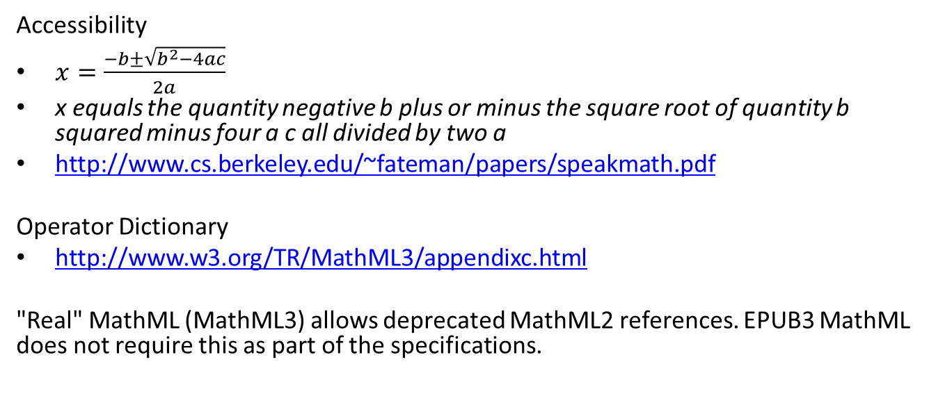
HTML5 Support: MathML Things to Note
Accessibility
$x=\frac{−b±\sqrt{b^{2}−4ac}}{2a}$
x equals the quantity negative b plus or minus the square root of quantity b squared minus four a c all divided by two a
http://www.cs.berkeley.edu/~fateman/papers/speakmath.pdf
Operator Dictionary
http://www.w3.org/TR/MathML3/appendixc.html
"Real" MathML (MathML3) allows deprecated MathML2 references. EPUB3 MathML does not require this as part of the specifications.

Slide 74
HTML5 Support: SVG
Within XHTML
  Inclusion
  Reference
SVG Content Documents

Slide 75
HTML5 Support: SVG
Use of an SVG must be declared in the manifest
  <manifest>
  <item id="ch1"
  href="chapter1.xhtml"
  media-type="application/xhtml+xml"
  property="svg"
  media-overlay="ch1_audio"/>

Slide 76

HTML5 Support: SVG
Embedded SVG
Accessibility

Slide 77
HTML5 Support: SVG
Embedded SVG
<?xml version="1.0" encoding="utf-8"?>
<!-- Generator: Adobe Illustrator 15.0.2, SVG Export Plug-In . SVG Version: 6.00 Build 0) -->
<!DOCTYPE svg PUBLIC "-//W3C//DTD SVG 1.1//EN" "http://www.w3.org/Graphics/SVG/1.1/DTD/svg11.dtd">
<svg version="1.1" id="Layer_1" xmlns="http://www.w3.org/2000/svg" xmlns:xlink="http://www.w3.org/1999/xlink" x="0px" y="0px" width="18.721px" height="18.721px" viewBox="0 0 18.721 18.721" enable-background="new 0 0 18.721 18.721" xml:space="preserve">
<g>
<path fill="none" stroke="#000000" stroke-width="1.5" stroke-linejoin="round" d="M1.354,1.05c0,0-0.045,0-0.045,0.047v11.041c0,0,0,0.046,0.045,0.046h16.01c0,0,0.047,0,0.047-0.046V1.096c0,0,0-0.047-0.047-0.047H1.354z"/>
<line fill="none" stroke="#000000" stroke-width="1.25" x1="3.562" y1="17.796" x2="15.157" y2="17.796"/>
<line fill="none" stroke="#000000" stroke-width="2" x1="9.358" y1="12.13" x2="9.358" y2="17.928"/>
</g>
<g>
<path d="M7.364,4.596C8.41,4.558,9.056,4.539,9.237,3.313h0.485v6.653H9.124V5.023h-1.76V4.596z"/>
</g>
</svg>

Slide 78
HTML5 Support: SVG
Embedded SVG
<g>
<title>Monitor</title>
<desc>An icon shaped like a computer monitor</desc>
<path fill="none" stroke="#000000" stroke-width="1.5" stroke-linejoin="round" d=""/>
<line fill="none" stroke="#000000" stroke-width="1.25" />
<line fill="none" stroke="#000000" stroke-width="2" />
</g>
<g>
<title>Chapter 1 Videos</title>
<desc>This image links to videos for chapter 1</desc>
<path d="M7.364,4.596C8.41,4.558,9.056,4.539,9.237,3.313h0.485v6.653H9.124V5.023h-1.76V4.596z"/>
</g>

Slide 79
HTML5 Support: SVG
SVG Content Documents
No Animation
svg:foreignObject and svg:title must be valid XHTML
Can have a viewport and be styled with CSS
Text will be selectable and searchable

Slide 80
HTML5 Support: Unicode PUA restriction
Private Use Area (PUA)
  Must reference an embedded font with the appropriate glyph

Slide 81
A basic introduction to epub and what’s new in 3.0
Review of tools and files we’ll be using
Dissection of an epub 2.0 file
Conversion of epub 2.0 to epub 3.0 (3pub to its friends)
  Overall structural changes
  New semantic information
  HTML5
  Media overlays
  Text-to-speech tools
  <switch> and backwards compatibility
  Canonical Fragment Identifiers
  Scripting
  CSS changes
Questions and (hopefully) answers!
Notes:
So, in the course of this workshop, we’re going to take an epub 2.0 file and turn it into an epub 3.0 (3pub) file.
Before we get into the nuts and bolts of how we do that, we’re going to go over the tools that we use and (briefly) how to set them up. We’ll also take a look at some of the other content that we’ve got that we’d like to include in the new file.
We’ll gloss over the epub 2.0 file that we’ve got, just to make sure that everyone is one the same page and understands the basics of how epub 2.0 works. If you have questions about 2.0 and how to generate epubs in general, we can give some quick pointers during this talk, and we’re happy to go into more depth afterwards.
After making sure we’re all on the same page with epub 2, we’ll head for 3pub. The first thing we’ll be looking at here are the overall structural changes to the format. These are changes that don’t add to the content—they just make the file a valid 3pub document. After that, we get into the new stuff that we can add in. The first content change we’ll be looking at is the new level of semantic information that 3pub introduces. This kind of information is great for enabling future re-use of your content; basically, it lets your device know more about the content it’s presenting.
HTML5 is next. It’s a really big subject, and there’s a full workhops about it right here after lunch, so while we’ll definitely get into some of the new features, we’ll be glossing over a lot. Mostly we’ll be looking at MathML, audio and video, triggers, and scripting. Following that, it’s Media Overlays, which are a method of integrating textual and audio content. Then we’ll look at backwards compatibility and ways that we can ensure that older reading systems don’t get left behind. We’ll finish up the presentation portion with a look at the CSS changes from epub 2.0.
We’ll finish up with a question and answer session. Since this is a big subject and a lot of these things build on each other, we’ll also be taking questions after each section. Feel free to ask away; this is a pretty technical subject, and odds are good that if you’re wondering it, ten or twelve other people are too.
We’ve also got a half-hour break scheduled in the middle there somewhere; we’ll take that as it comes

Slide 82
Media Overlays
Provide a way to link audio content and text content together.
While audio is playing, the related parts of the text have a CSS style applied to them.
Video content may be supported in the future.
Synchronization can be as granular as you want.
"Should" be supported if audio is.
Supported in XHTML and SVG documents, though results may be inconsistent in SVG.
Notes:
This pretty much sums up what media overlays are all about. They synchronize your audio content to your text content and allow you to do things like highlight the text being read. At present, there’s no way to synchronize video with your text content, though that may be supported in the future.
You can have the synchronization be by the word, phrase, sentence, paragraph—whatever you like. You could conceivably even do it by the letter or by the chapter if you wanted to, though either of those would probably be of limited use. The more fine-grained you make the synchronization, the more work you’re going to have to do and the bigger your file is going to be, so there’s a balance to be struck.
Media Overlay support is not required, though the IDPF says that Reading Systems should support it if they can play audio files. Clearly, devices that can’t play audio can’t do the media overlay, and since we don’t know at this point how many Reading Systems will support it, it’s probably best not to commit a ton of resources to Media Overlays just yet.
Media Overlays are designed to work with XHTML text files. They should theoretically work with SVG files as well, but we’re warned that results may be inconsistent. Sounds like Media Overlays on manga might not be happening just yet, then.

Slide 83
Media Overlays: getting technical
Uses a subset of SMIL (Synchronized Multimedia Integration Language).
Requires markup of each granular bit on content in the text document.
SMIL uses track times and text markup to synchronize audio and text.
Two main elements:
  <par>: things that happen in parallel
  <seq>: things that happen in sequence

Slide 84
Notes:
Here we’ve got an XHTML document. This is the first few paragraphs of the excellent Cory Doctorow short story The Right Book, from his collection With a Little Help. The accompanying audio track was read by Neil Gaiman. It seemed like a good text to use as an example, as the story is all about the future of bookselling. Cory is good enough to release his books under a Creative Commons license, which means that we’re able to tinker with them like this.
You can see that every sentence in the text has been put inside a span with a numbered id—well, except for the title, which has id="title". This is how the SMIL file knows which bit of text to highlight or underline or show in Comic Sans or whatever you’ve decided to make your overlay do. (Don’t really make it do Comic Sans).
It also has a <section> element, which has been given an id="ch2". This is important, as it indicates the chunk of text that will have a media overlay applied to it. You can also see that its been assigned an epub:type="chapter", for semantic goodness.
So that’s pretty straightforward there. Now we’ll move on to the SMIL.

Slide 85
Notes:
Here we have the SMIL file. It’s got an XML NameSpace declaration at the top, and it’s got the epub prefix declared as well. Then it’s got a <body> element, just like any XHTML document, followed by a <seq>. You may have noticed that there’s no <head> to this file—that’s because the <head> is optional for SMIL.
The <seq> has an id so that we can reference it elsewhere. It’s also got the attribute epub:textref="chapter2.xhtml#ch2. This is required for any <seq>. It points back to that id="ch2" we saw on the <section> in the XHTML document. Like that <section>, it’s also been assigned the epub:type="chapter".
Everything else in the SMIL file is inside the <seq>. Everything inside of a <seq> happens in sequence, which means that we’re going to process one element until it’s done, then more on to the next, and then the next, until we get to the end of the document. The first element inside the <seq> is a <par>. Inside that <par>, there is a <text> element and an <audio> element. Since things inside <par>s happen in parallel, both of them will happen at the same time.
You can see that the <text> element only has one attribute: a source. That source points to one of those ID’ed spans that we saw in the XHTML document. You can also have an id in here if you like, but that’s it for attributes on your <text> element in SMIL files.
The <audio> element has a source just like the <text> did, but it references an mp3 file that we’ve got in a folder named "audio" that’s in the OEBPS folder. It’s also got two more attributes: clipBegin and clipEnd. Those specify times from the audio track. There are a number of time specification formats that you can use; you can see that some of these have decimals and some don’t, and some have a trailing "s" for seconds as well. There are plenty of other variations that work. The current version of EpubCheck seems to have some problems with any time declarations with a decimal in their regular expression, but I’m sure they’ll get that hammered out soon.

Slide 86
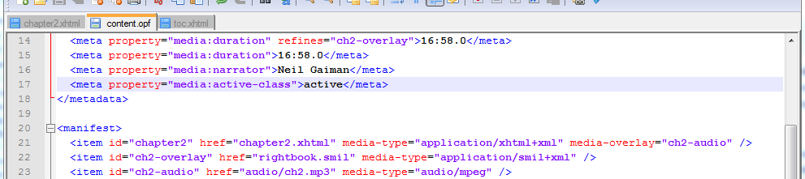
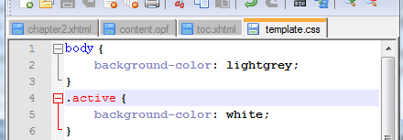
Changes in other files
Notes:
We’ve taken care of the SMIL and the XHTML document, but there are a few more changes we need to make before we’re done with the Media Overlay. First, we need to make a few changes to the OPF file. First, we’ll have to be sure that the audio file and the SMIL are declared in the <manifest>, because everything has to be declared in there. We also have to make sure that the Reading System knows which audio file is associated with what text file, so the declaration for chapter2.xhtml gets media-overlay="ch2-audio" added to it.
The duration of the individual media overlays and of the entire book must also be declared in the OPF file. In this example, there’s only the one file, so only one duration to include. If there were multiple audio files to declare, the overall length would be declared as shown, and each individual file would get "refines=#[id of SMIL]" included after the duration declaration.
Finally, up in the metadata, we can set the name of the CSS style we want to apply to the text being read. We do this with <meta property="media:active-class">active</meta>. Then in the appropriate CSS file, we set the styles for the active class. You can see that what we’ve done here is give the entirety of the body a light grey background, but giving the active text a white background instead. It’s important to pay attention to the order you have these declarations in the CSS file, of course, since just like any other CSS they’ll cascade. It would be safest to have the active class style at the bottom so that you know it doesn’t get overwritten.
If no media:active-class has been set in the <metadata>, the Reading System will apply its own style to the active text.

Slide 87
Escapability and Skippability
Skippability: Skipping, e.g., all page numbers
Escapability: Skipping an individual nested structure (like a sidebar)
epub:type is used to determine what gets skipped or escaped
These require that <seq>s be nested where appropriate

Slide 88
Overlays and embedded media
Can be included, but don’t use scripts to control them, as they might conflict
Audio or video that is referenced by src="…" has special rules:
  Controls have to be hidden during playback. Scripts, too.
  Media have to be in a stopped state, not autoplaying.
  Embedded media will only play as long as its text is active.
  The audio track needs two volume controls, one for the overlay and one for the embed.
  Embedded media have to end up in a stopped state.
Notes:
This is complex stuff. These rules only apply to the stuff already in the media overlay, not to other media files that are not declared in the SMIL. As the IDPF says, " It is recommended that overlapping audio situations are carefully examined and dealt with at production stage, as Reading Systems are not required to handle simultaneous volume levels in any particular way."

Slide 89
A basic introduction to epub and what’s new in 3.0
Review of tools and files we’ll be using
Dissection of an epub 2.0 file
Conversion of epub 2.0 to epub 3.0 (3pub to its friends)
  Overall structural changes
  New semantic information
  HTML5
  Media overlays
  Text-to-speech tools
  <switch> and backwards compatibility
  Canonical Fragment Identifiers
  Scripting
  CSS changes
Questions and (hopefully) answers!
Notes:
So, in the course of this workshop, we’re going to take an epub 2.0 file and turn it into an epub 3.0 (3pub) file.
Before we get into the nuts and bolts of how we do that, we’re going to go over the tools that we use and (briefly) how to set them up. We’ll also take a look at some of the other content that we’ve got that we’d like to include in the new file.
We’ll gloss over the epub 2.0 file that we’ve got, just to make sure that everyone is one the same page and understands the basics of how epub 2.0 works. If you have questions about 2.0 and how to generate epubs in general, we can give some quick pointers during this talk, and we’re happy to go into more depth afterwards.
After making sure we’re all on the same page with epub 2, we’ll head for 3pub. The first thing we’ll be looking at here are the overall structural changes to the format. These are changes that don’t add to the content—they just make the file a valid 3pub document. After that, we get into the new stuff that we can add in. The first content change we’ll be looking at is the new level of semantic information that 3pub introduces. This kind of information is great for enabling future re-use of your content; basically, it lets your device know more about the content it’s presenting.
HTML5 is next. It’s a really big subject, and there’s a full workhops about it right here after lunch, so while we’ll definitely get into some of the new features, we’ll be glossing over a lot. Mostly we’ll be looking at MathML, audio and video, triggers, and scripting. Following that, it’s Media Overlays, which are a method of integrating textual and audio content. Then we’ll look at backwards compatibility and ways that we can ensure that older reading systems don’t get left behind. We’ll finish up the presentation portion with a look at the CSS changes from epub 2.0.
We’ll finish up with a question and answer session. Since this is a big subject and a lot of these things build on each other, we’ll also be taking questions after each section. Feel free to ask away; this is a pretty technical subject, and odds are good that if you’re wondering it, ten or twelve other people are too.
We’ve also got a half-hour break scheduled in the middle there somewhere; we’ll take that as it comes

Slide 90
Text to Speech facilities
Pronunciation Lexicons
  Apply rules to the entire document
Inline SSML (Synthesized Speech Markup Language)
  Apply rules to specific instances
CSS Speech Features
Notes:
There are three different ways you can control the text-to-speech functions of a document. The first two involve Synthesized Speech Markup Language, or SSML.
Like CSS, you can have inline text-to-speech rules, or you can have them in an external document. That external document is called a Lexicon, rather than a Stylesheet. Also like CSS, Inline SSML will take precedence over SSML from a Lexicon.
The third way to control text-to-speech is through the use of CSS Speech features. These are a new addition to CSS, and allow control over a number of things which we’ll go over shortly.

Slide 91
Inline SSML
ssml:alphabet
  Specifies which phonemic/phonetic alphabet is being used to represent pronunciation
ssml:ph
  Uses that alphabet to specify pronunciation
Notes:
Inline SSML eliminates the need for Reading Systems to have to recognize which word you’re telling them how to pronounce; instead, you tell them exactly which word you’re talking about.

Slide 92
The basics of PLS
Grapheme: specifies how the word is written
Phoneme: specifies how the word is pronounced
Lexeme: ties together grapheme and phoneme
<lexicon>
<lexeme>
<grapheme/>
<phoneme/>
</lexeme>
</lexicon>
Notes:
This is a PLS (Pronunciation Lexicon Specification) at its most basic. It’s quite straightforward, really: The Lexicon is full of Lexemes, which are basically "whole" words. Each Lexeme is split into a Grapheme, which shows how the word is written, and a Phoneme, which tells the Reading System how to pronounce the word.
PLSs can get much more complex than this, of course. You can have multiple phonemes, for example for "I have read…" vs. "I will read…" You can also have multiple graphemes, which can be useful when dealing with British and American English in the same text. You can even specify graphemes in multiple scripts, which can be very handy for languages like Japanese, where there are two syallabaries and one set of ideographs in addition to the roman alphabet in use.

Slide 93
Declaring a PLS
<html>
<head>
<link rel="pronunciation" type="application/pls+xml" hreflang="…" href="speech/file.pls"/>
</head>
…
</html>
Notes:
If you’re including a PLS, you need to reference it in the head of the XHTML document that has the PLS associated with it. You can declare multiple PLS documents if you need to—for multiple languages, perhaps. You’ll also, of course, need to declare the PLS file in the <manifest>

Slide 94
CSS Speech Properties
cue: plays sound clips before or after
pause: silence before or after, like padding
rest: silence before or after, like margin
speak: turns aural rendering on or off
speak-as: many options for rendering numbers, spelling, and punctuation
voice-family: specify age, gender, specific voice instance, etc.
Notes:
CSS speech doesn’t drill down into exactly how you pronounce words, like SSML does. Instead, it deals with things that happen around words; you can use it to control the timing of words by lengthening the time between them, or you can play sounds before or after words. You can use speak-as to spell out words instead of pronouncing them as words, or to speak the name of each punctutation item—something that gets back to accessibility in MathML. You can specify a specific type of voice that the Reading System should use in rendering content, which could be particularly handy for rendering dialogues. And of course, you can turn aural rendering on or off.

Slide 95
A basic introduction to epub and what’s new in 3.0
Review of tools and files we’ll be using
Dissection of an epub 2.0 file
Conversion of epub 2.0 to epub 3.0 (3pub to its friends)
  Overall structural changes
  New semantic information
  HTML5
  Media overlays
  Text-to-speech tools
  <switch> and backwards compatibility
  Canonical Fragment Identifiers
  Scripting
  CSS changes
Questions and (hopefully) answers!

Slide 96
HTML5 Support: epub:switch
Definition:
Conditional insertion of XML content (IF you have the ability to do X, do X; ELSE, do Y).
Uses
Scripting and experimentation
Targeting specific devices/software
Backwards compatibility
Must be included in the manifest item properties tag.
Example:
<item properties="switch scripted mathml" id="c1" href="c1.xhtml" media-type="application/xhtml+xml"/>

Slide 97
HTML5 Support: epub:switch
Structure:
<epub:switch id="Optional">
<epub:case id="optional" required-namespace="http://www.w3.org/required" >Case1</epub:case>
<epub:case required-namespace="http://www.w3.org/required">Case2</epub:case>
<epub:case required-namespace="http://www.w3.org/required">Case5</epub:case>
<epub:case required-namespace="http://www.w3.org/required">Case...</epub:case>
<epub:default>Standard XHTML</epub:default>
</epub:switch>

Slide 98
HTML5 Support: epub:switch
epub:case Elements
required-namespace element is required. In URI form, it identifies the XML vocabulary that the reading system must support in order to process the case
Must contain alternate representations of the same information.
Should be ordered in preference of optimal rendering format
Information inside a case element should be well formed in its own context and match the context in which it is used (eg no block elements if the switch is used inline)
epub:default Element
Must be valid XHTML
Required as the last child of the switch
id is optional

Slide 99
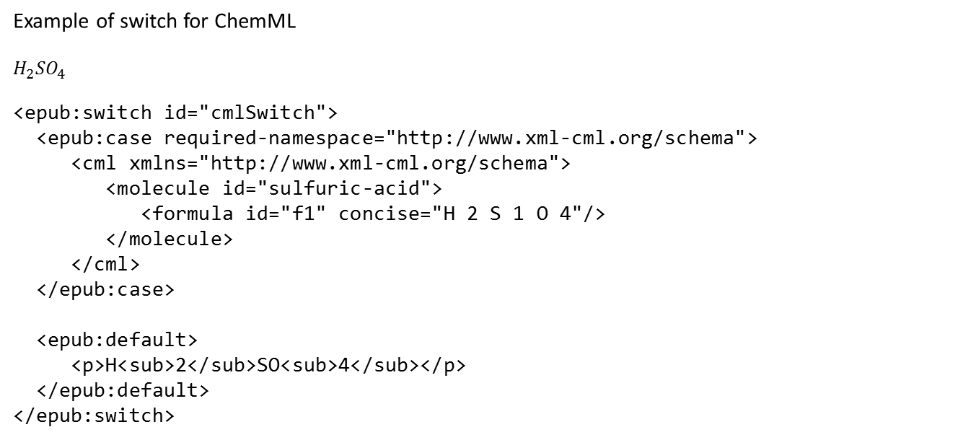
HTML5 Support: epub:switch
Example of switch for ChemML
$$H_{2}{SO}_{4}$$
<epub:switch id="cmlSwitch">
<epub:case required-namespace="http://www.xml-cml.org/schema">
<cml xmlns="http://www.xml-cml.org/schema">
<molecule id="sulfuric-acid">
<formula id="f1" concise="H 2 S 1 O 4"/>
</molecule>
</cml>
</epub:case>
<epub:default>
<p>H<sub>2</sub>SO<sub>4</sub></p>
</epub:default>
</epub:switch>

Slide 100

HTML5 Support: epub:switch
Example of switch for MathML: $2x+y−z$
<epub:switch id="mathmlSwitch">
<epub:case required-namespace="http://www.w3.org/1998/Math/MathML">
<math xmlns="http://www.w3.org/1998/Math/MathML">
<mrow>
<mn>2</mn>
<mo> &#x2061;<!--INVISIBLE TIMES--></mo>
<mi>x</mi>
</mrow>
<mrow>
<mo>+</mo>
<mi>y</mi>
<mo>-</mo>
<mi>z</mi>
</mrow>
</math>
</epub:case>
<epub:default>
<p>2x + y - z</p>
</epub:default>
</epub:switch>

Slide 101
A basic introduction to epub and what’s new in 3.0
Review of tools and files we’ll be using
Dissection of an epub 2.0 file
Conversion of epub 2.0 to epub 3.0 (3pub to its friends)
  Overall structural changes
  New semantic information
  HTML5
  Media overlays
  Text-to-speech tools
  <switch> and backwards compatibility
  Canonical Fragment Identifiers
  Scripting
  CSS changes
Questions and (hopefully) answers!

Slide 102
Canonical Fragment Identifiers
Canonical Fragment Identifiers are a way of referencing any point in any epub—much like a hyperlink, but not limited to just going to things with IDs on them.

Slide 103
Canonical Fragment Identifiers
CFIs always start from the <package>
Just like URLs, slashes mean you’re drilling down a level.
  Rather than directories, these levels are <elements/>
  If an element has an id, you must include that id
  Navigation between elements is done by counting ("go three block down and…")
  Counting uses even numbers for elements (number of blocks) and odd numbers for things that aren’t elements (number of storefronts)

Slide 104
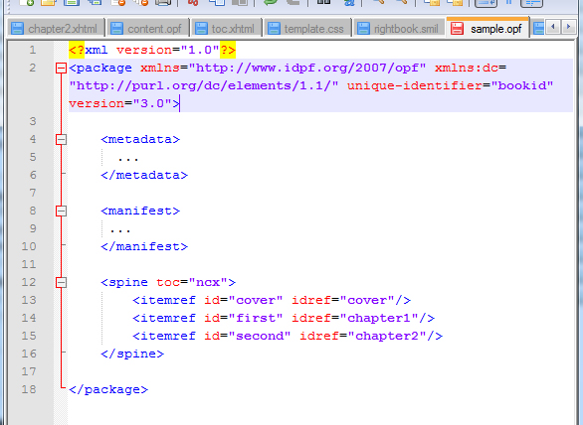
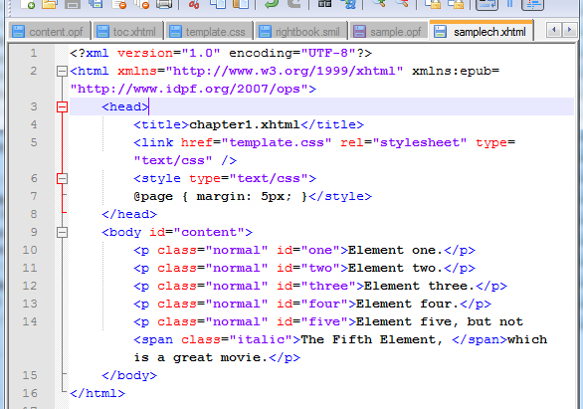
epubcfi(/6/4[first]!/4[content]/10[five]/3:10)
epubcfi is required to tell the RS this is a CFI.

Slide 105
epubcfi(/6/4[first]!/4[content]/10[five]/3:10)
/6 points to the 3rd element in the <package>, which is the <spine>
1
2
3

Slide 106
epubcfi(/6/4[first]!/4[content]/10[five]/3:10)
/4[first]:the 2nd element in the spine, which also has an id of first
1
2
3

Slide 107
epubcfi(/6/4[first]!/4[content]/10[five]/3:10)
!/4[content] : the next document, and within it the 2nd element, which has an id of content
1
2

Slide 108
epubcfi(/6/4[first]!/4[content]/10[five]/3:10)
/10[para05] : the 5th element, which has an id of para05
1
2
3
4
5

Slide 109
epubcfi(/6/4[first]!/4[content]/10[five]/3:10)
First non-element
<p class="normal" id="five">Element five, but not
<span class="italic">The Fifth Element, </span>
which is a great movie.</p>
First element
Second non-element
Ten character offset
Notes:
3pub by Digital Bindery is licensed under a Creative Commons Attribution-NonCommercial-ShareAlike 3.0 Unported License.

Slide 110
CFIs: Terminating steps
Character Offset uses : (and a number of characters)
Temporal Offset uses ~ (and a time stamp)
Spatial Offset uses @ (and two colon-separated numbers)
Text Location in [brackets] requires certain text around the point. [a, great] would find the point our example pointed to.
Side Bias lets you declare whether the location should be displayed with the content before or after it.
  [;s=b] or [;s=a]

Slide 111
A basic introduction to epub and what’s new in 3.0
Review of tools and files we’ll be using
Dissection of an epub 2.0 file
Conversion of epub 2.0 to epub 3.0 (3pub to its friends)
  Overall structural changes
  New semantic information
  HTML5
  Media overlays
  Text-to-speech tools
  <switch> and backwards compatibility
  Canonical Fragment Identifiers
  Scripting
  CSS changes
Questions and (hopefully) answers!
Notes:
So, in the course of this workshop, we’re going to take an epub 2.0 file and turn it into an epub 3.0 (3pub) file.
Before we get into the nuts and bolts of how we do that, we’re going to go over the tools that we use and (briefly) how to set them up. We’ll also take a look at some of the other content that we’ve got that we’d like to include in the new file.
We’ll gloss over the epub 2.0 file that we’ve got, just to make sure that everyone is one the same page and understands the basics of how epub 2.0 works. If you have questions about 2.0 and how to generate epubs in general, we can give some quick pointers during this talk, and we’re happy to go into more depth afterwards.
After making sure we’re all on the same page with epub 2, we’ll head for 3pub. The first thing we’ll be looking at here are the overall structural changes to the format. These are changes that don’t add to the content—they just make the file a valid 3pub document. After that, we get into the new stuff that we can add in. The first content change we’ll be looking at is the new level of semantic information that 3pub introduces. This kind of information is great for enabling future re-use of your content; basically, it lets your device know more about the content it’s presenting.
HTML5 is next. It’s a really big subject, and there’s a full workhops about it right here after lunch, so while we’ll definitely get into some of the new features, we’ll be glossing over a lot. Mostly we’ll be looking at MathML, audio and video, triggers, and scripting. Following that, it’s Media Overlays, which are a method of integrating textual and audio content. Then we’ll look at backwards compatibility and ways that we can ensure that older reading systems don’t get left behind. We’ll finish up the presentation portion with a look at the CSS changes from epub 2.0.
We’ll finish up with a question and answer session. Since this is a big subject and a lot of these things build on each other, we’ll also be taking questions after each section. Feel free to ask away; this is a pretty technical subject, and odds are good that if you’re wondering it, ten or twelve other people are too.
We’ve also got a half-hour break scheduled in the middle there somewhere; we’ll take that as it comes

Slide 112
Scripting
Definition
Javascript
One new object
epubReadingSystem
Supports methods
hasFeature
dom-manipulation
layout-changes
touch-events
mouse-events
keyboard-events
spine-scripting
Notes:
hasFeature
dom-manipulation Scripts may make structural changes to the document’s DOM (applies to spine-level scripting only).
layout-changes Scripts may modify attributes and CSS styles that affect content layout (applies to spine-level scripting only).
touch-events The device supports touch events and the Reading System passes touch events to the content.
mouse-events The device supports mouse events and the Reading System passes mouse events to the content.
keyboard-events The device supports keyboard events and the Reading System passes keyboard events to the content.
spine-scripting Spine-level scripting is supported.

Slide 113
Scripting
All documents containing or referring to scripts must indicate this in the manifest:
<manifest>
<item id="ch1"
href="chapter1.xhtml"
media-type="application/xhtml+xml"
property="scripted"
media-overlay="ch1_audio"/>
Container-constrained vs spine-level

Slide 114
Scripting
A few rules:
Supporting scripts is optional for the reading system, but if it does not support scripting, it must process fallbacks
Container-constrained scripts cannot affect other XHTML documents or its own containing rectangle
For security reasons, ereaders may not allow the document to access other documents, the hard drive, the network, or encrypted/unencrypted portions of the ebook, or save or retrieve cookies

Slide 115
Scripting
Best practices:
Restricting scripts to container-constrained inclusion will provide more consistency and will have less interference with non-scripted content
Declarative techniques and avoiding scripting when practical are the best ways to ensure longevity and accessibility
Provide an opportunity for the user to allow/disallow network connections or other scripting functions that execute outside of the confines of the ebook
Avoid keyboard event triggers
Keep in mind the variability of reading devices when scripting

Slide 116
A basic introduction to epub and what’s new in 3.0
Review of tools and files we’ll be using
Dissection of an epub 2.0 file
Conversion of epub 2.0 to epub 3.0 (3pub to its friends)
  Overall structural changes
  New semantic information
  HTML5
  Media overlays
  Text-to-speech tools
  <switch> and backwards compatibility
  Canonical Fragment Identifiers
  Scripting
  CSS changes
Questions and (hopefully) answers!

Slide 117
CSS Differences
Based on CSS 2.1 with some exceptions.
It does not support:
  position: fixed
  direction
  unicode-bidi

Slide 118
CSS Differences
@media
@import
@namespace
CSS Multi-column layout module
  No column-span
  oeb-column-number (deprecated) = column-count (preferred)
text-transform
  fullwidth is -epub-fullwidth
  fullsize-kana is -epub-fullsize-kana
list-style-type:
  cjk-ideographic
  hebrew
  hiragana
  hiragana-iroha
  katakana
  katakana-iroha
Notes:
column behavior in overflow conditions is unstable

Slide 119
CSS Differences
display: oeb-page-head
display: oeb-page-foot
<div class="runningHead" style="display:none; display:oeb-page-head">
<div class="runningFoot" style="display:none; display:oeb-page-foot">

Slide 120
CSS Differences
Some CSS 3.0 specifications with the -epub- prefix attached are supported
-epub-cue
-epub-pause
-epub-rest
-epub-speak
-epub-speak-as
-epub-voice-family
-epub-hyphens
  Except -epub-hyphens: all;
-epub-line-break
-epub-text-align-last
-epub-text-emphasis
-epub-text-emphasis-color
-epub-text-emphasis-style
-epub-word-break
-epub-ruby-position
  over
  under
  inter-character
CSS3 Writing Modes (with -epub- prefix)
  except direction and unicode-bidi

Slide 121
CSS Differences
Fonts
OpenType and Web Open Font Format (WOFF) fonts are supported
@font-face
font-family
font-style
font-weight
src
unicode-range
Font Fallback
In addition to @font-face, reference a generic font using the font-family property

Slide 122
Thank You!
Questions?
Amanda Gomm
@agomm
Tom McCluskey
@tommccluskey
www.digitalbindery.com | info@digitalbindery.com | @digitalbindery

